Slide 1
UNIT III
LAPLACE TRANSFORMS
Department of Mathematics,
SRMIST, Kattankulathur.

Slide 2
INTRODUCTION
Basic Definitions
Transforms of Simple Functions
Basic Operational properties
Transforms of Derivatives and Integrals
Initial and Final Value Theorems
Laplace Transform of Periodic Functions
Inverse Transforms
Convolution Theorem
Applications of Laplace Transforms for solving First and Second Order Linear Ordinary Differential Equation

Slide 3
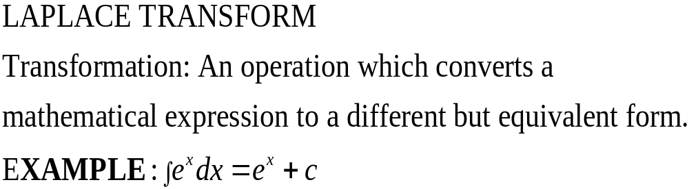

Slide 4
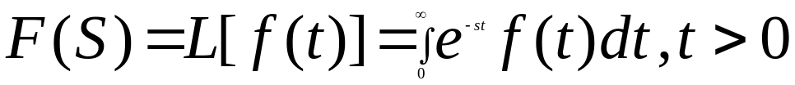
Laplace Transform: A Function f(t) be continuous and defined for all positive values of t. The Laplace Transform of f(t) associates a function S defined by the equation

Slide 5
SUFFICIENT CONDITION FOR THE EXISTENCE OF LAPLACE TRANSFORM
1) f(t) should be either piecewise continuous or continuous function in closed interval [a,b].
2) Function should possess exponential order.

Slide 6
Piecewise continuous function: A function f(t) is said to be piecewise continuous in the closed interval if it is defined in that interval and in such a way that interval is divided into a finite number of subintervals in each of which f(t) is continuous.

Slide 7
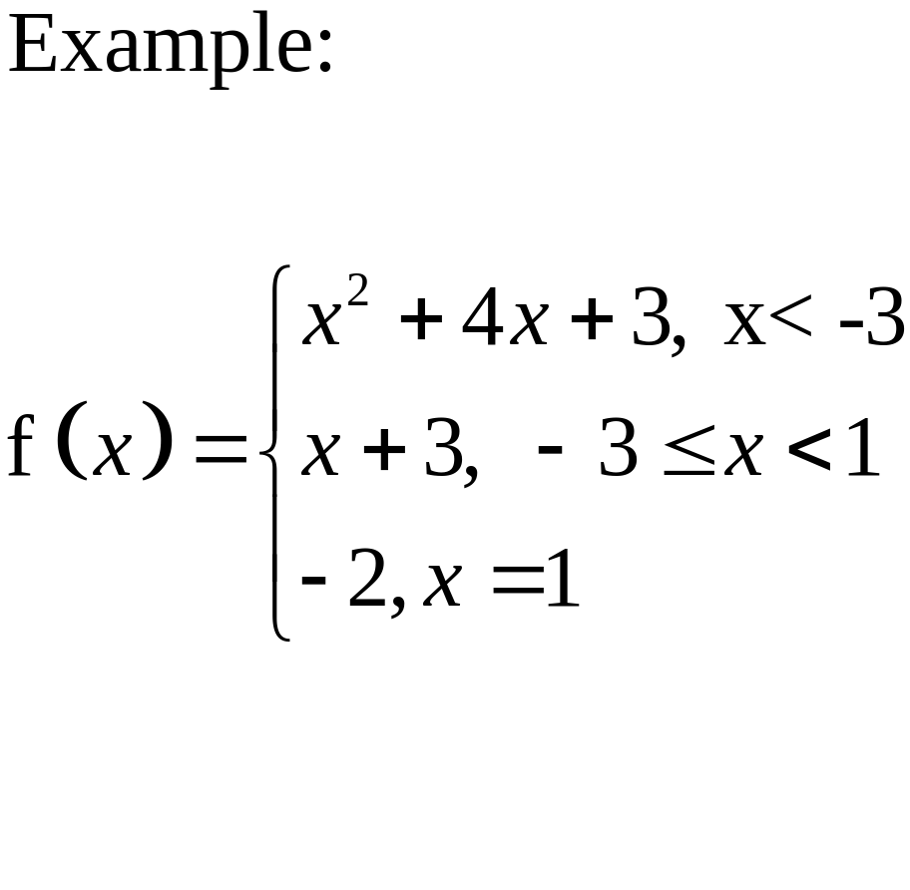

Slide 8
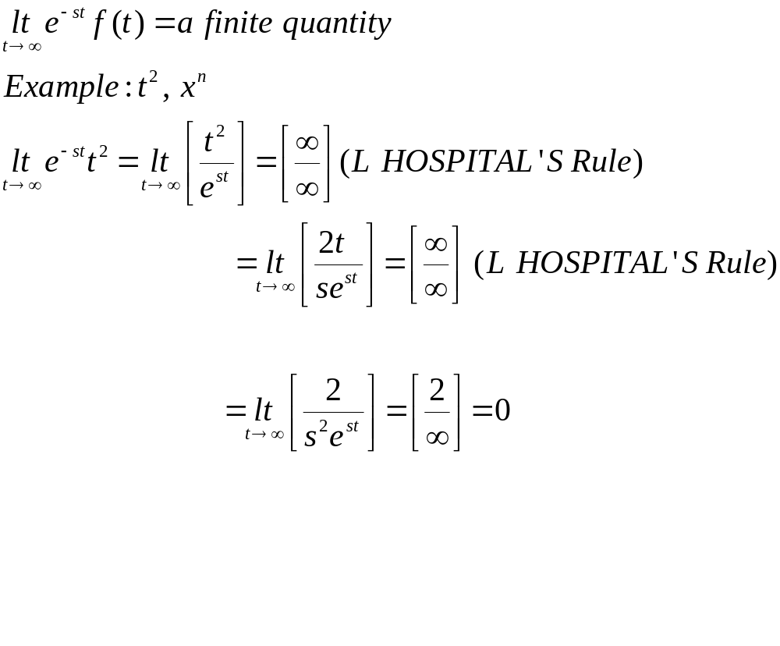
Exponential Order: A function f(t) is said to be of exponential order if

Slide 9
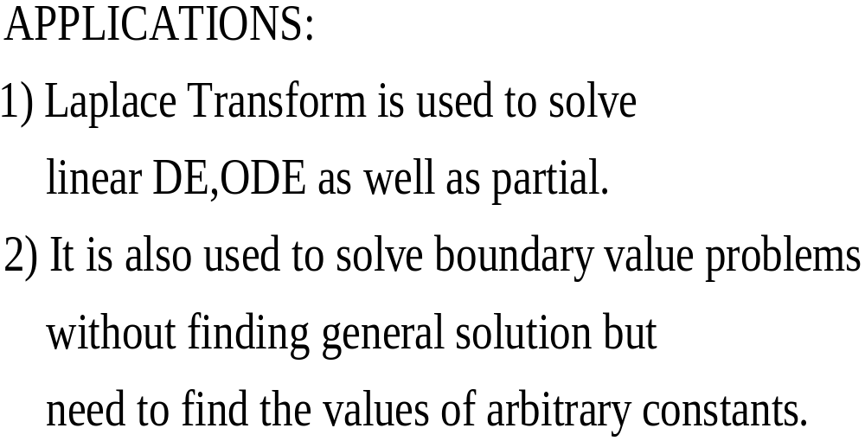

Slide 10
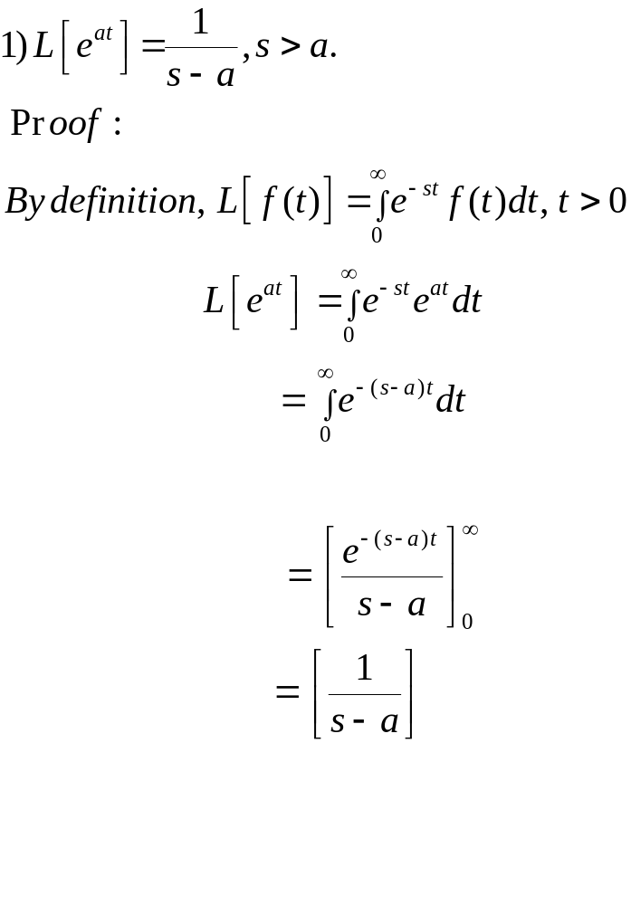
IMPORTANT RESULTS

Slide 11
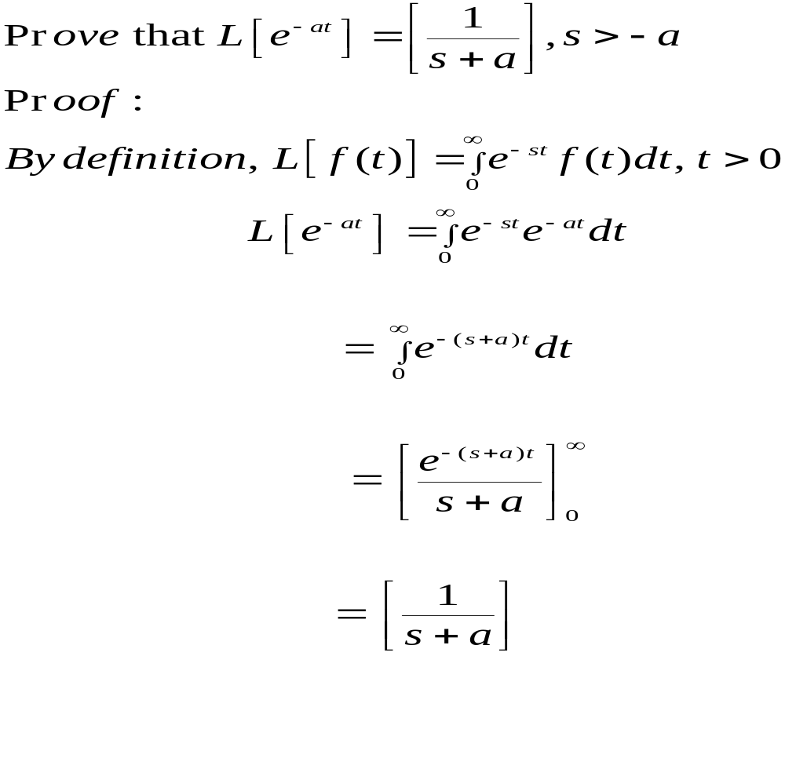

Slide 12
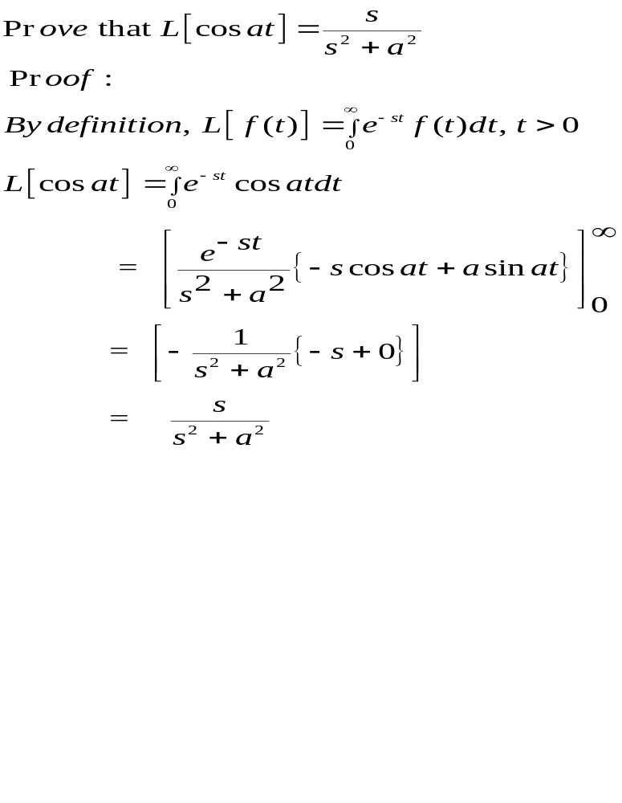

Slide 13
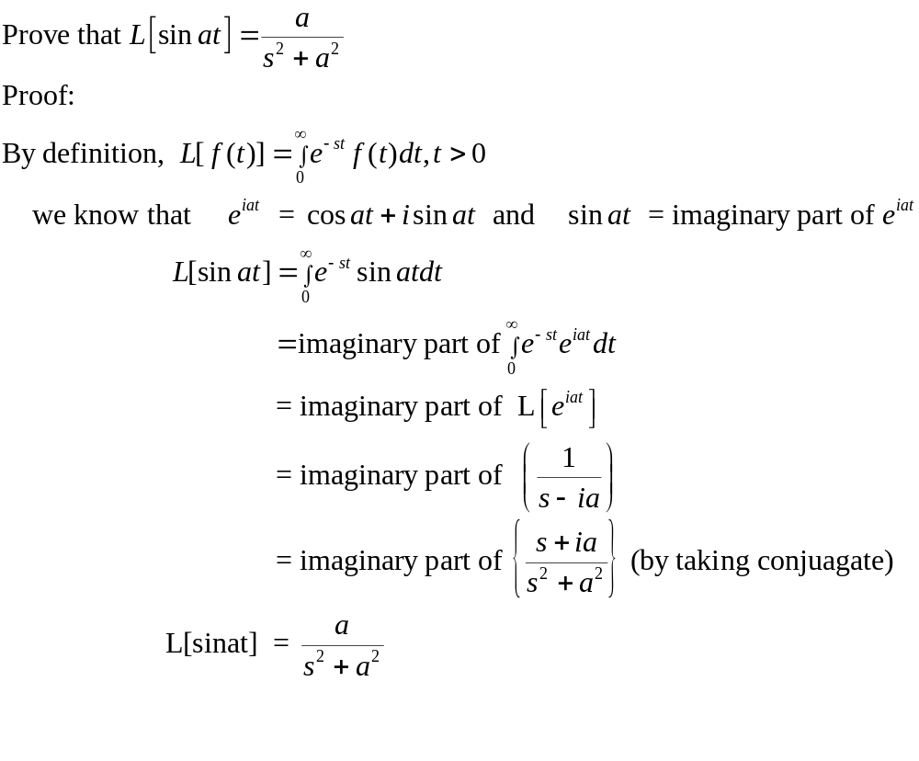

Slide 14
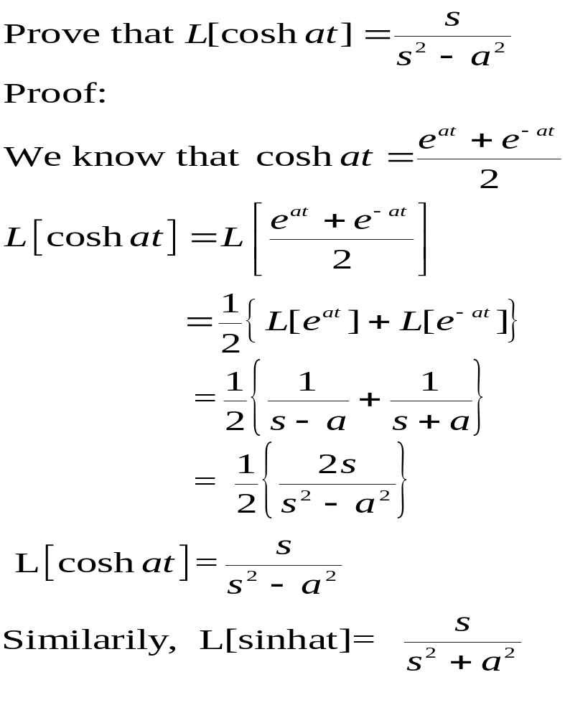

Slide 15
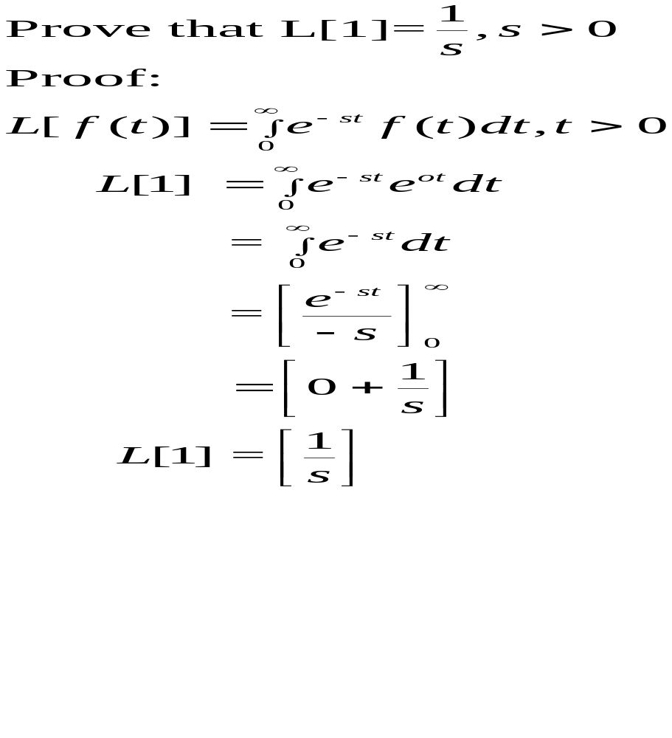

Slide 16
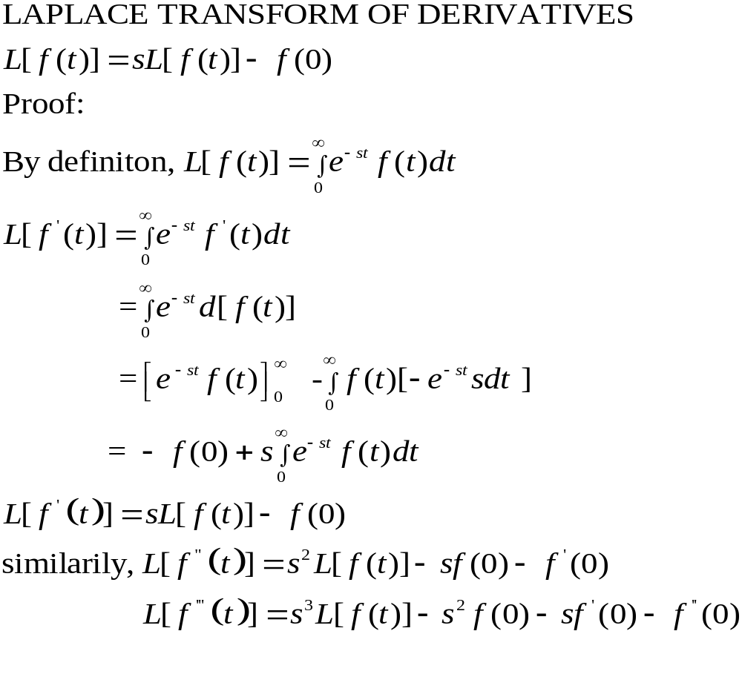

Slide 17
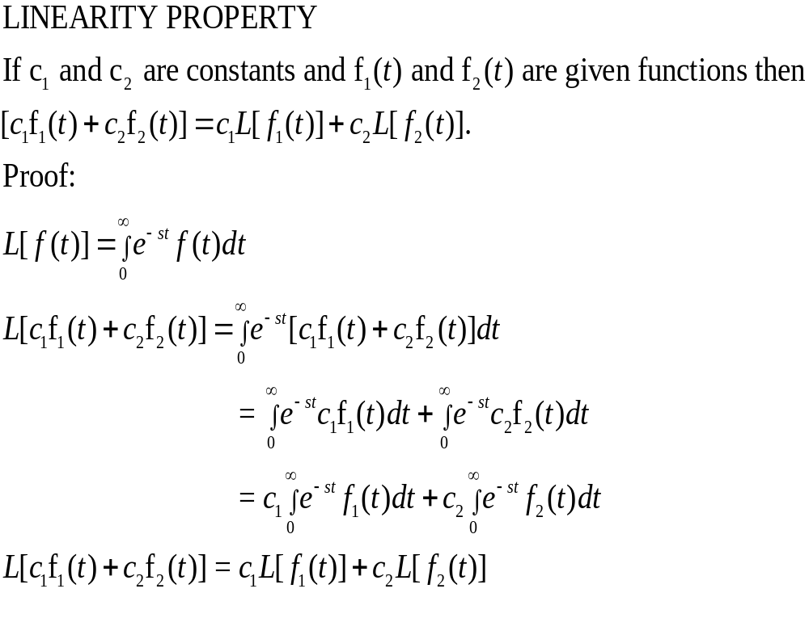

Slide 18
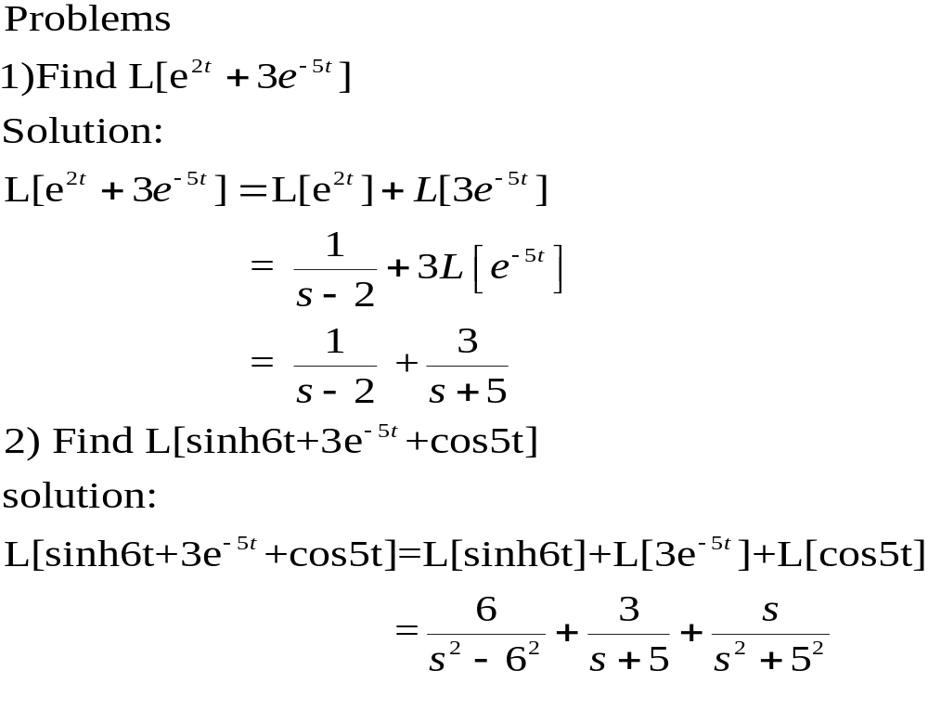

Slide 19
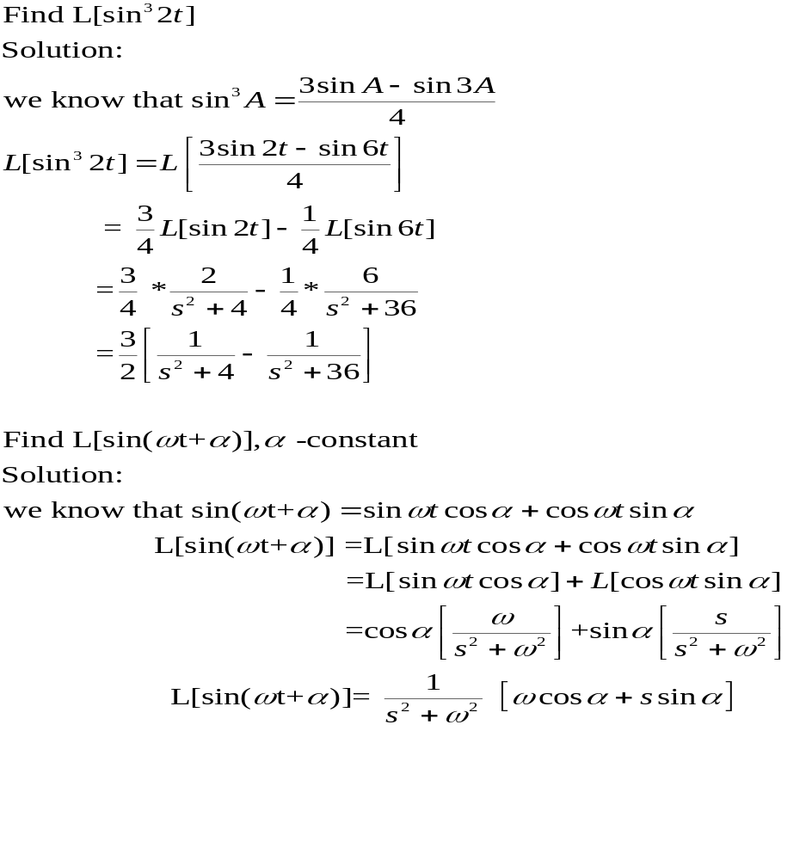

Slide 20
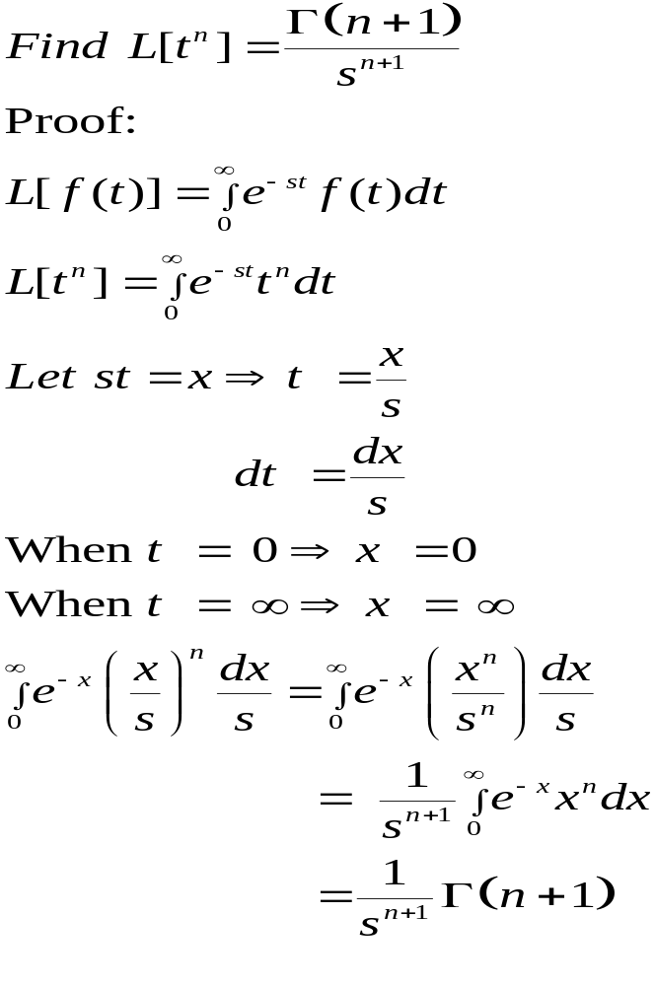

Slide 21
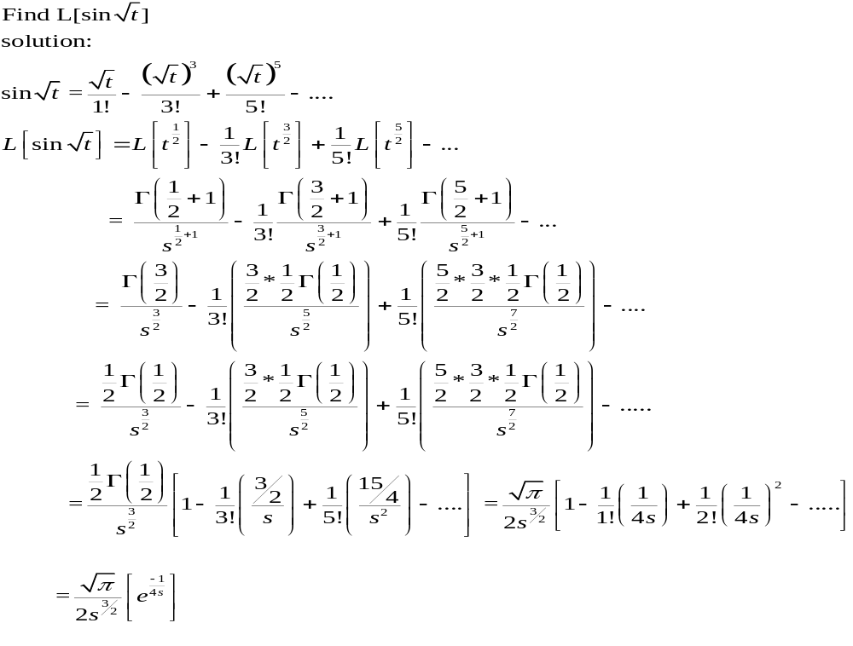

Slide 22
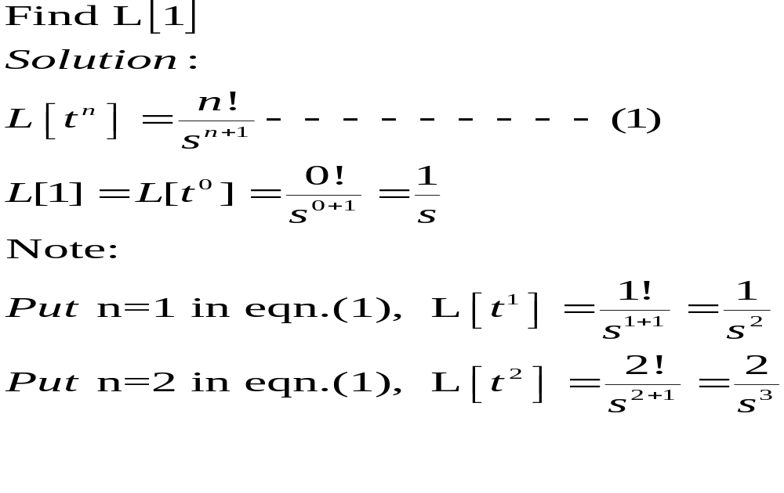

Slide 23
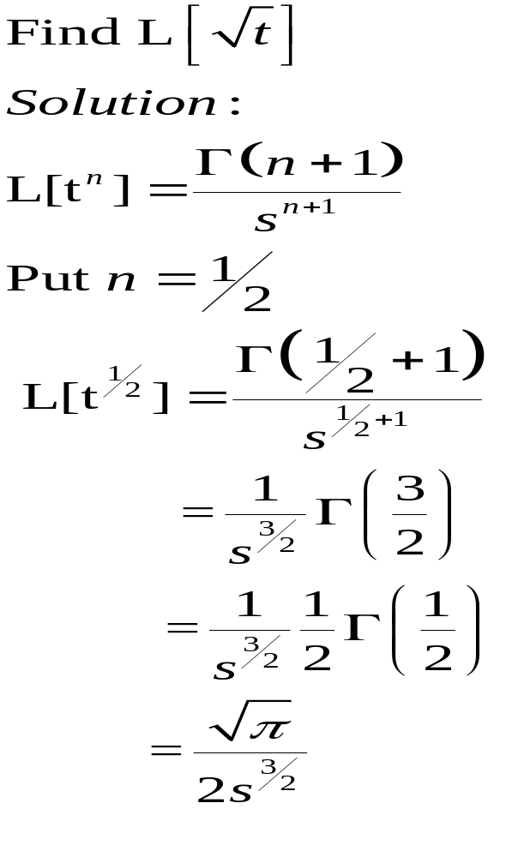

Slide 24
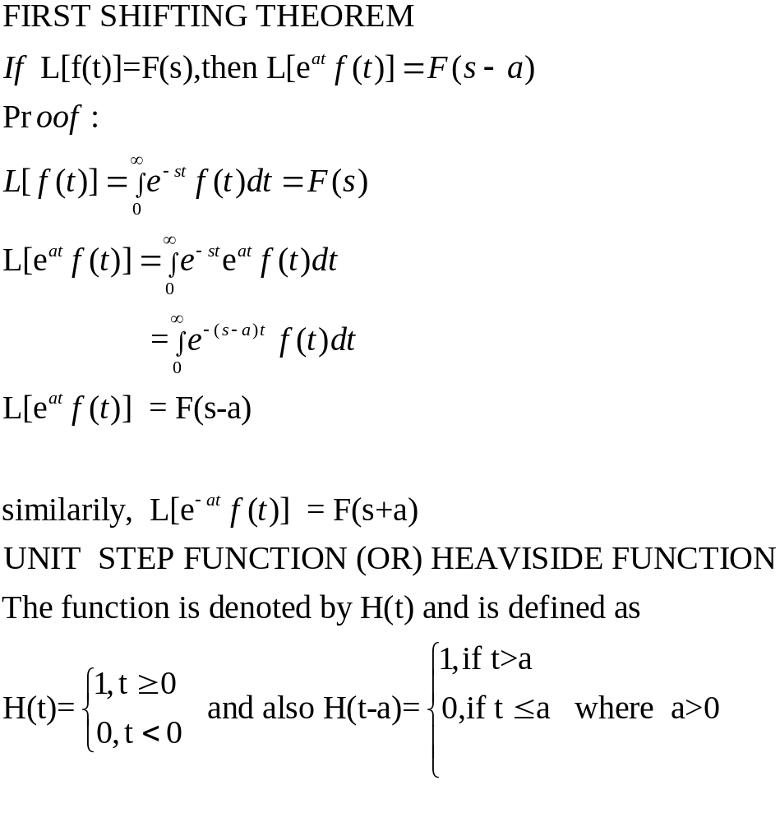

Slide 25
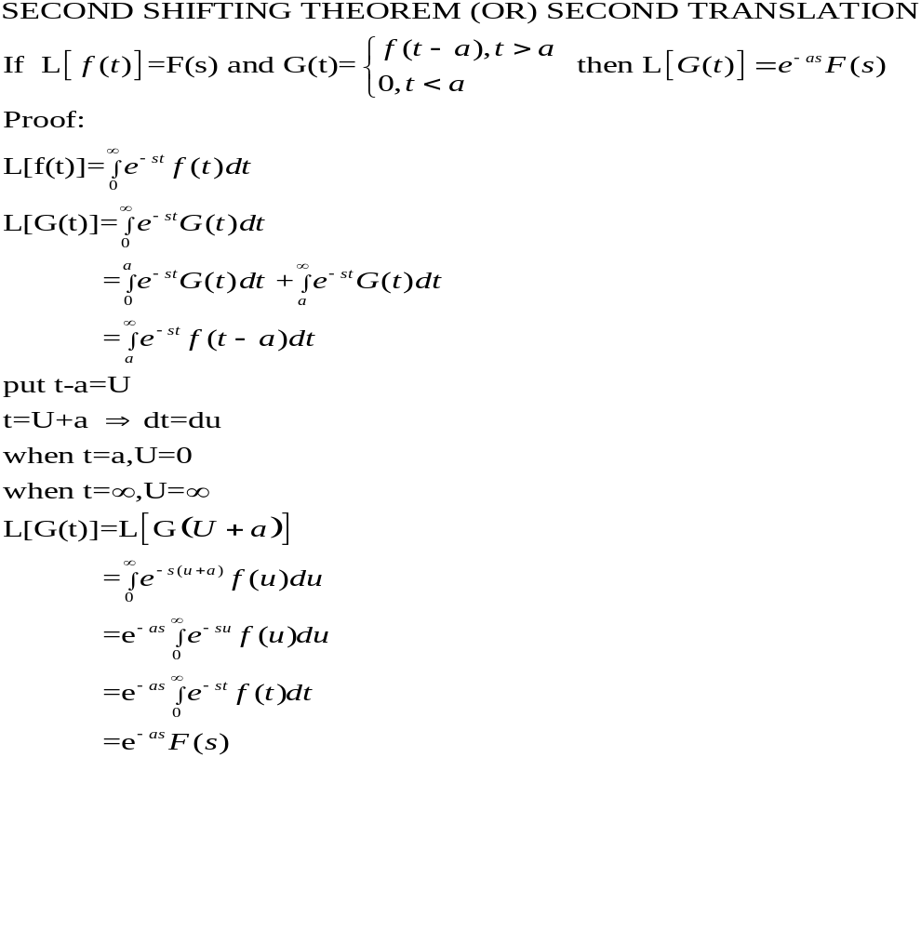

Slide 26
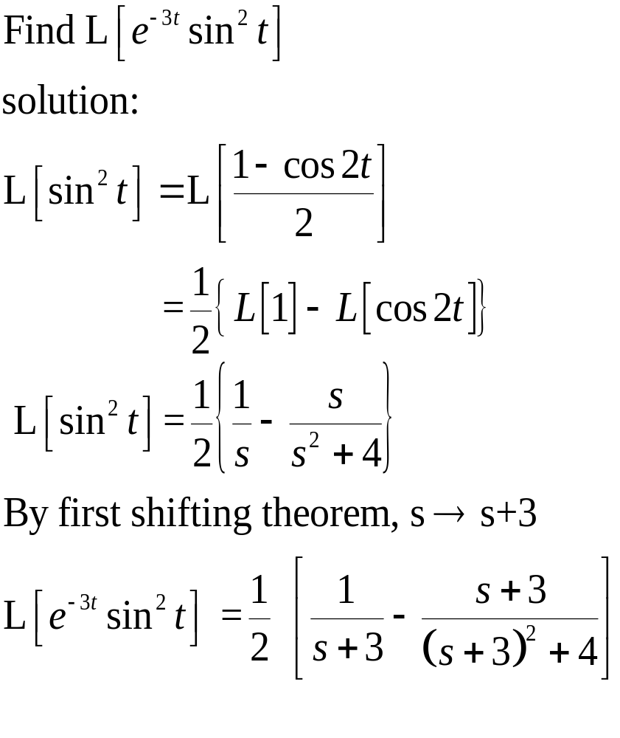

Slide 27
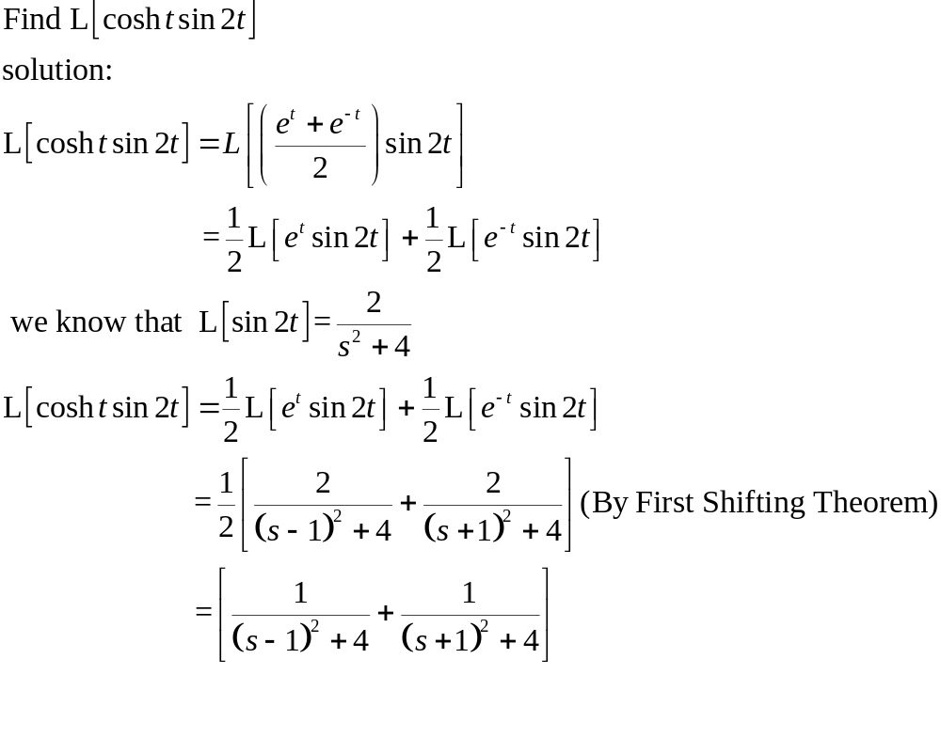

Slide 28
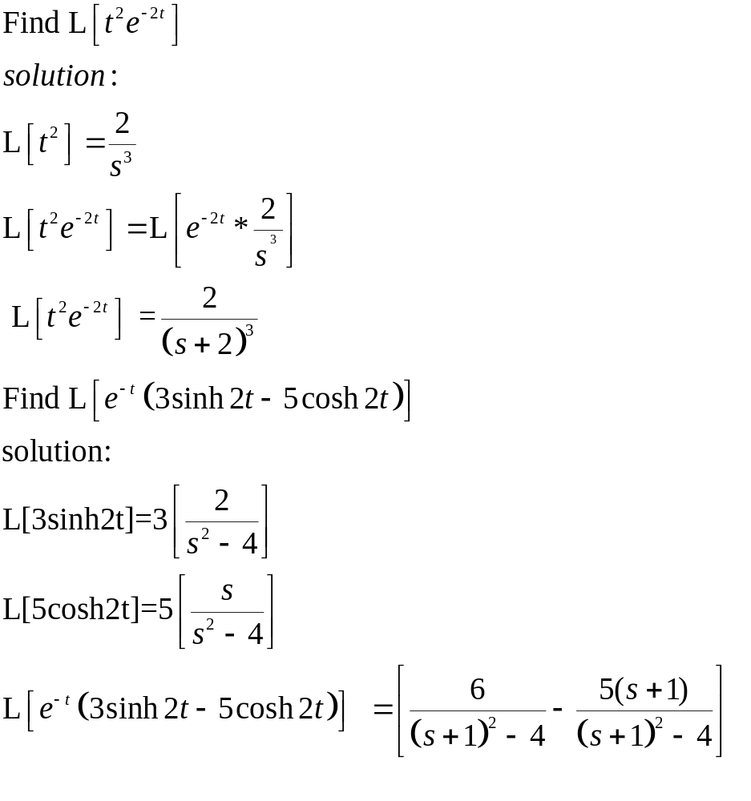

Slide 29
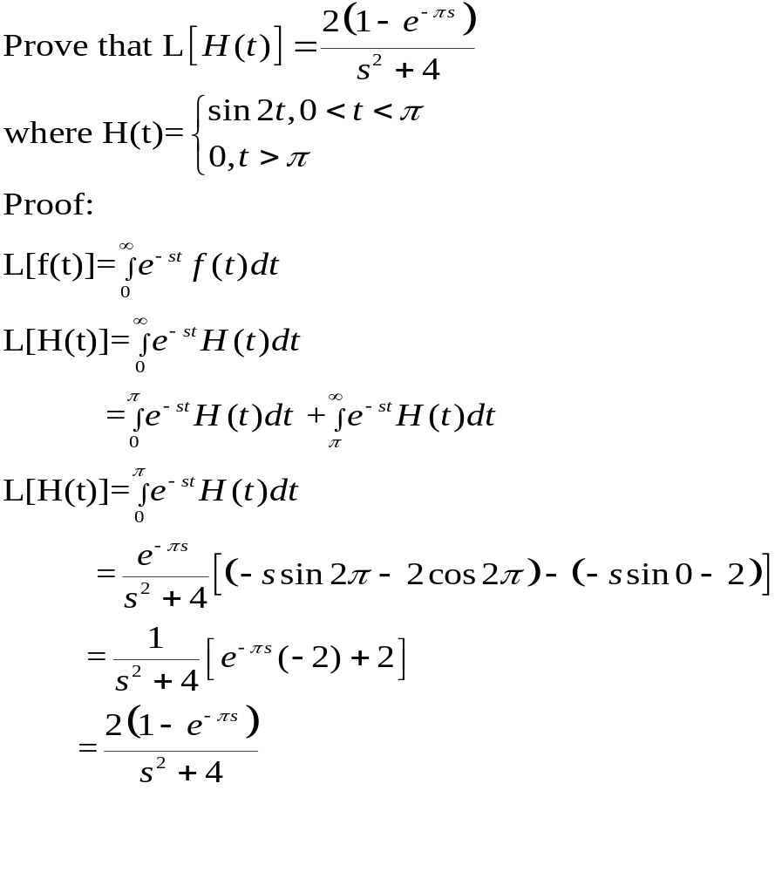

Slide 30
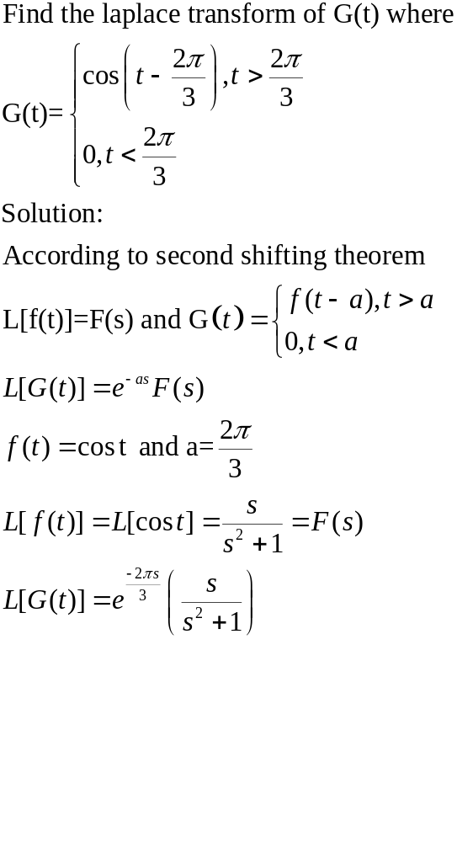

Slide 31
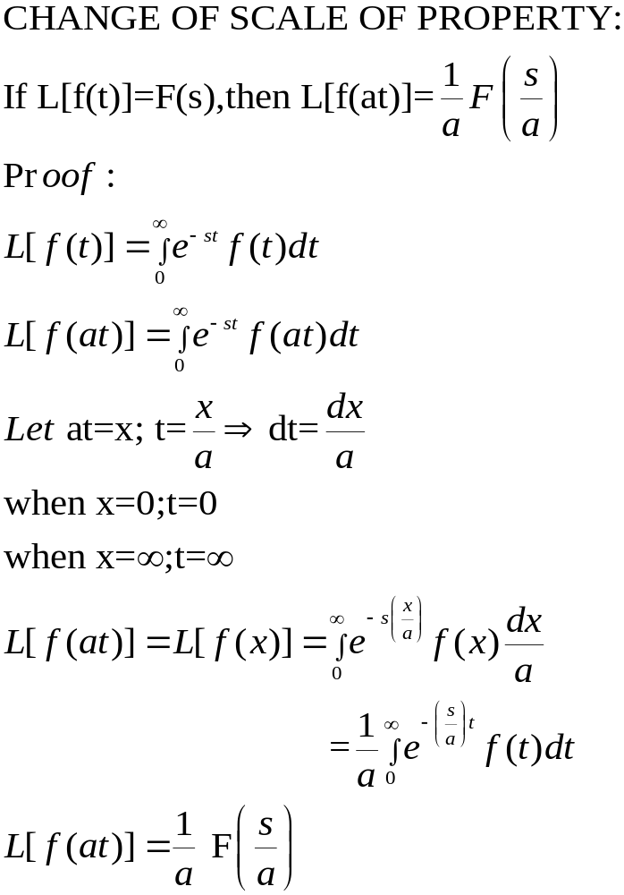

Slide 32
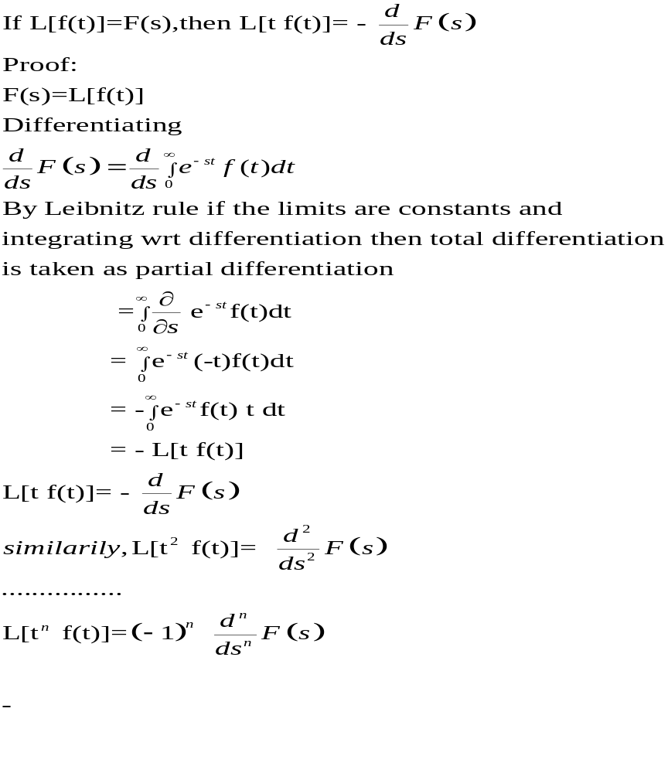

Slide 33
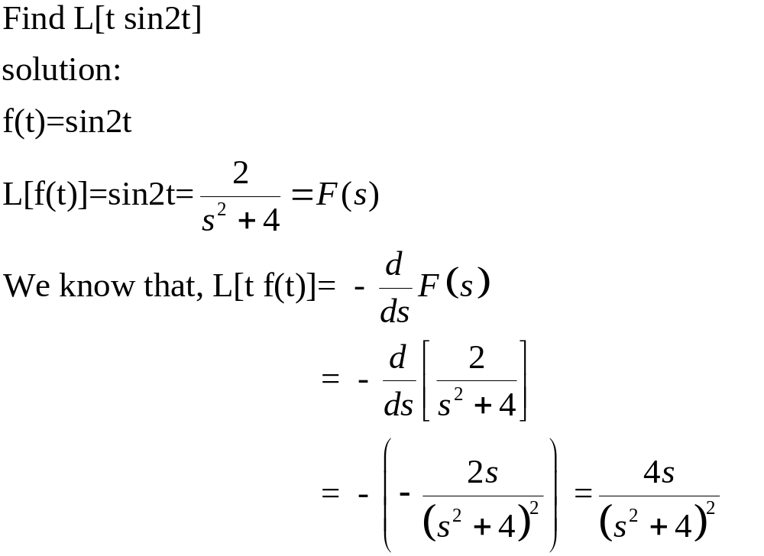

Slide 34
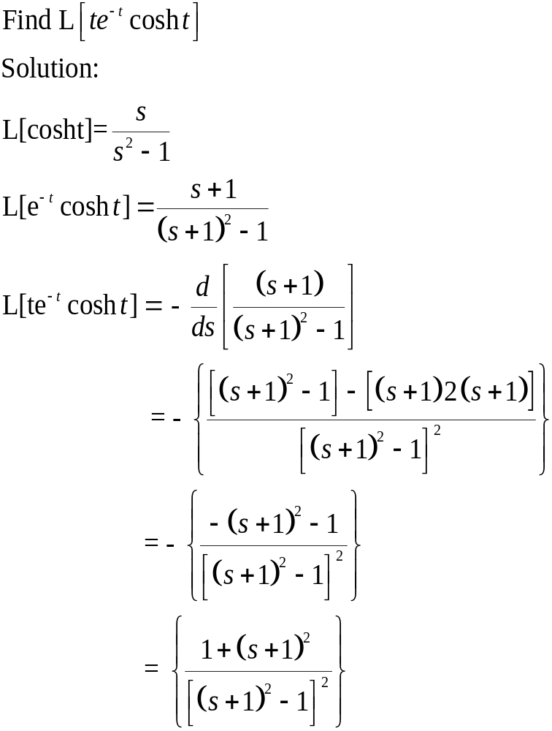

Slide 35
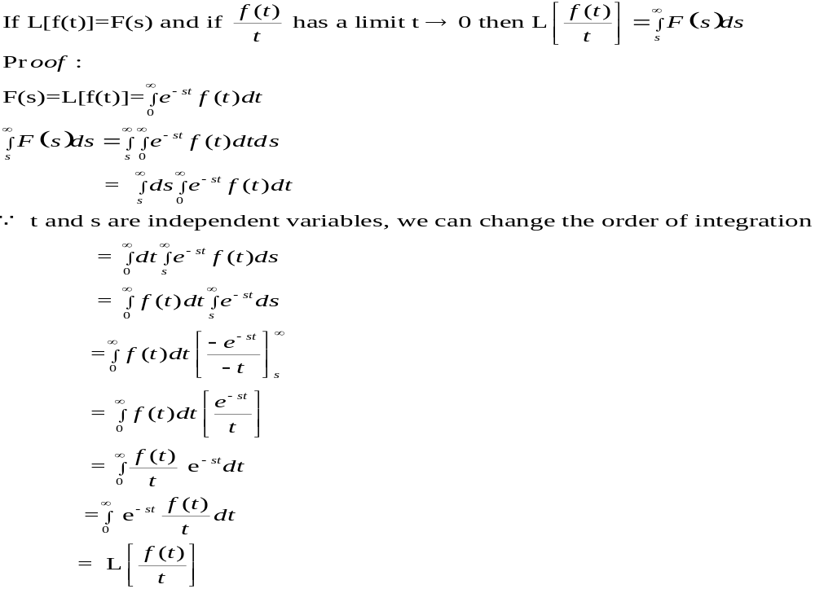

Slide 36
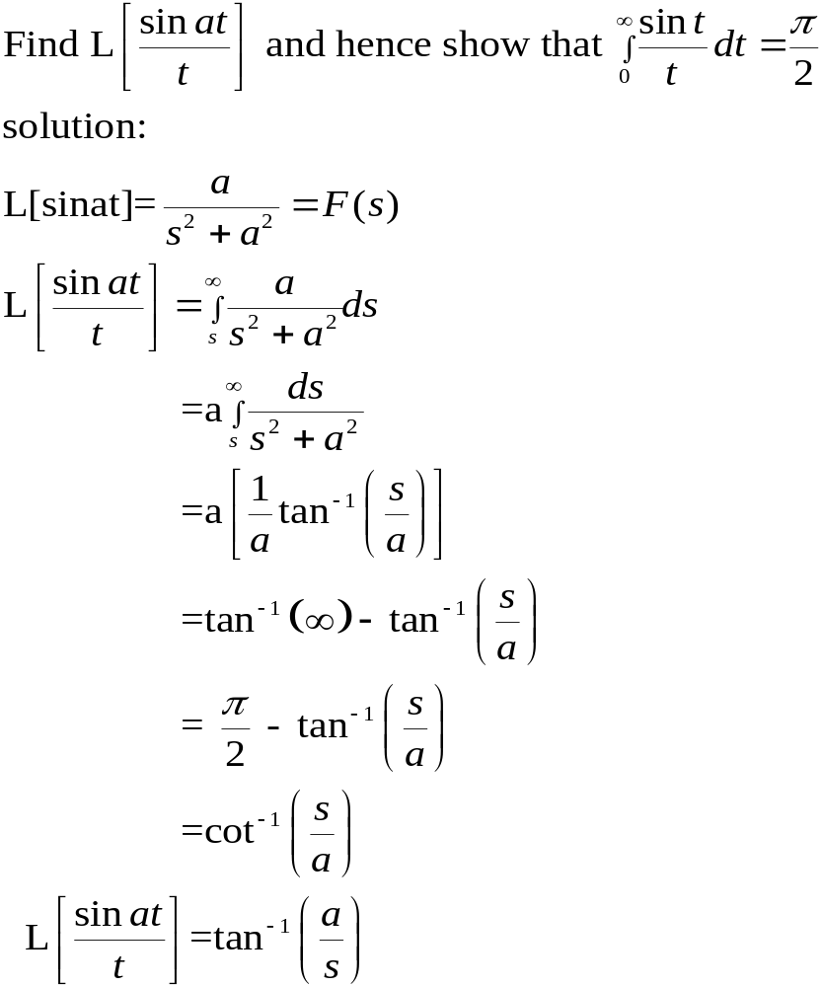

Slide 37
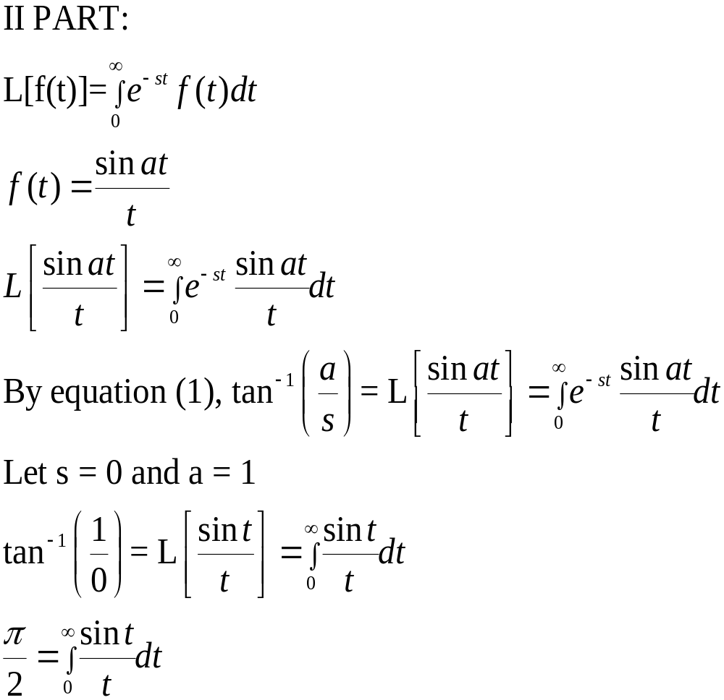

Slide 38
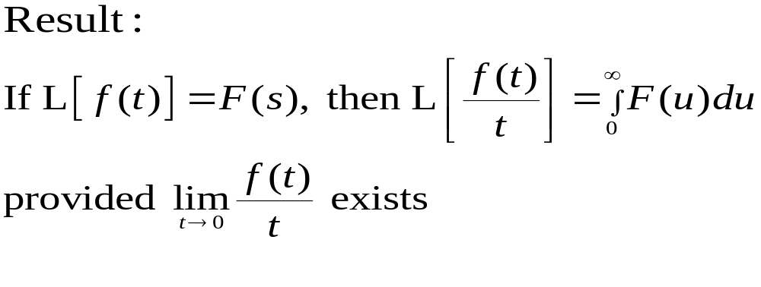

Slide 39
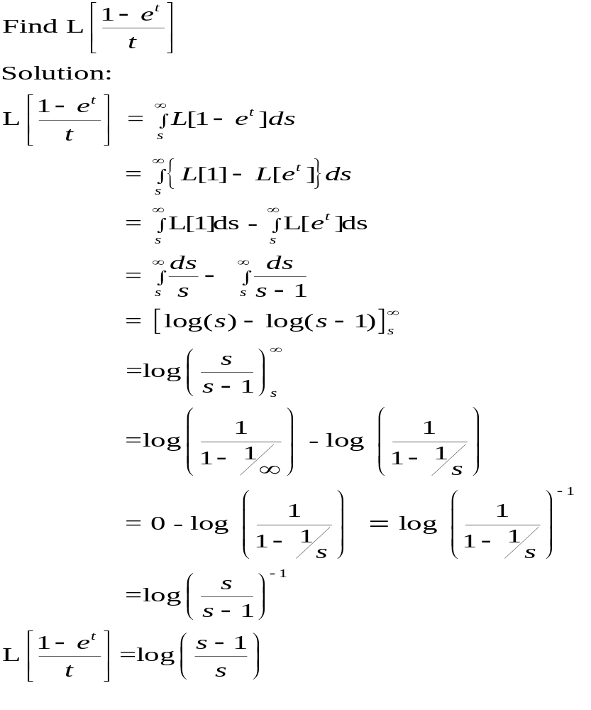

Slide 40
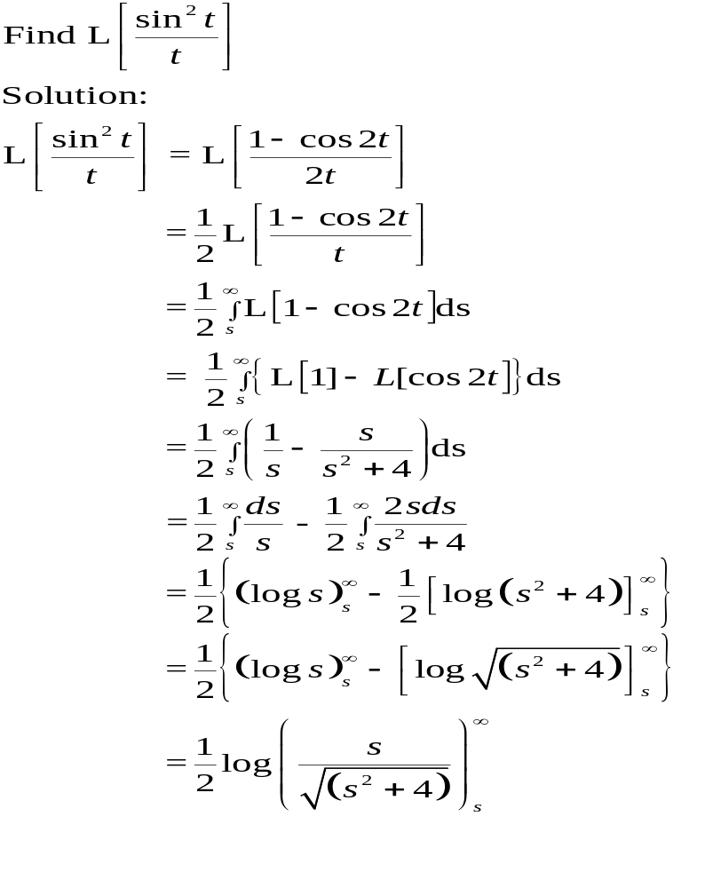

Slide 41
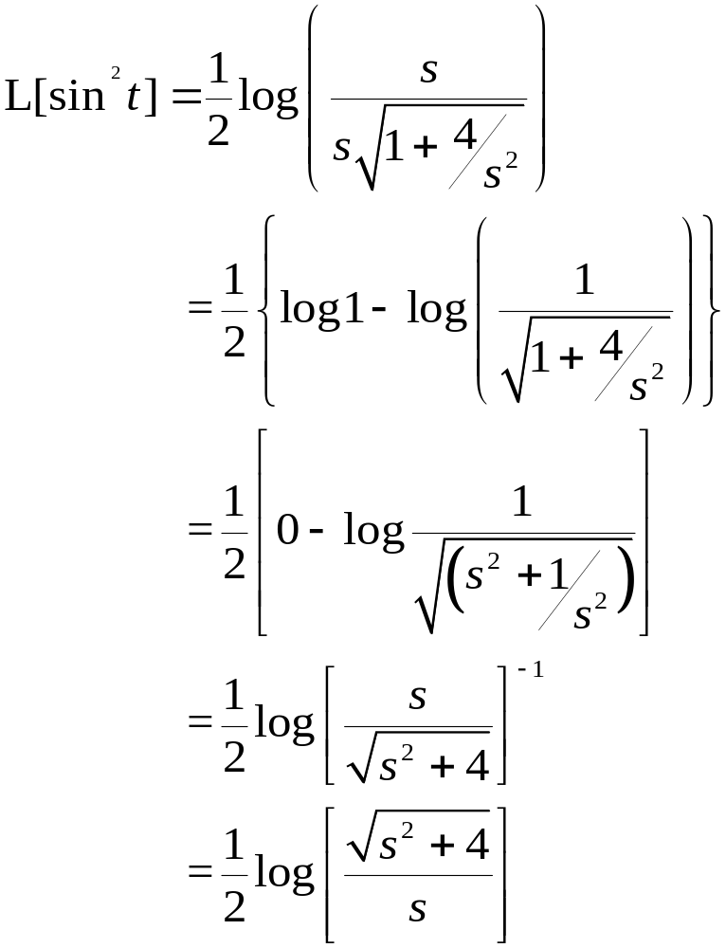

Slide 42
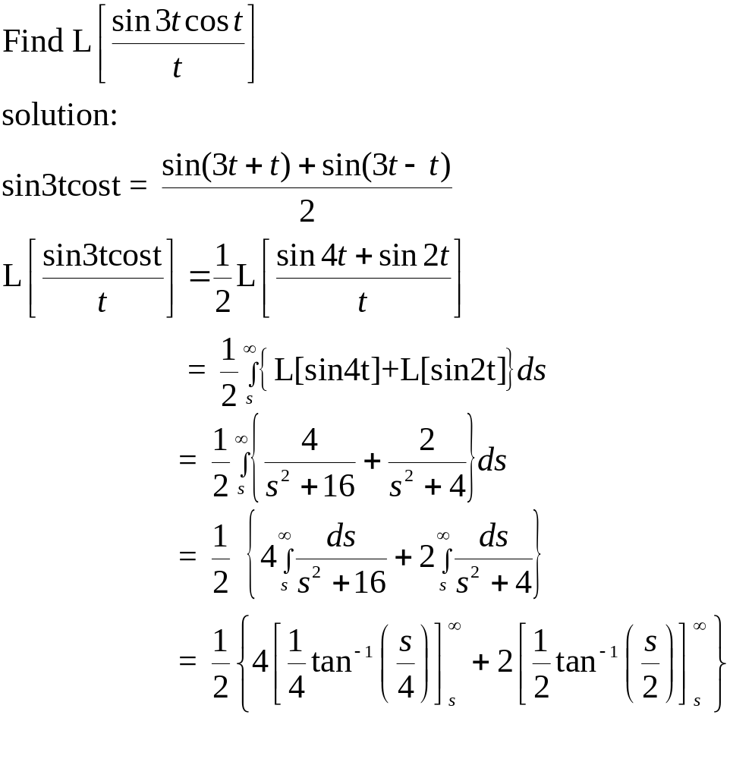

Slide 43
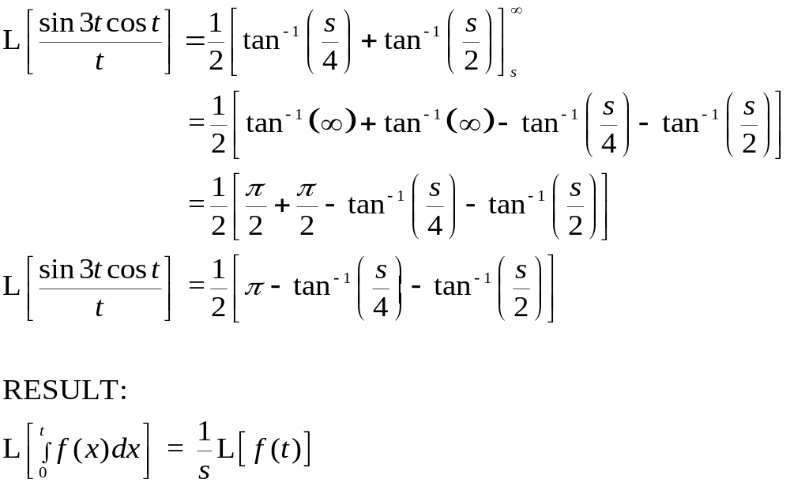

Slide 44
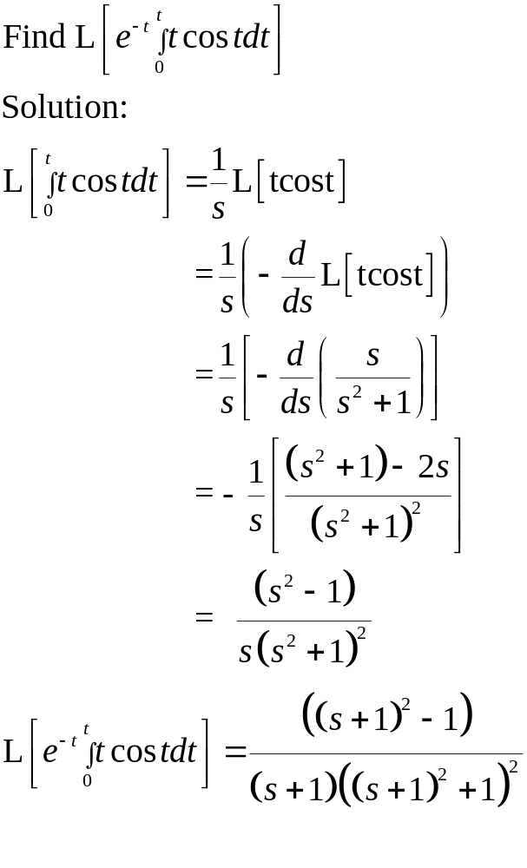

Slide 45
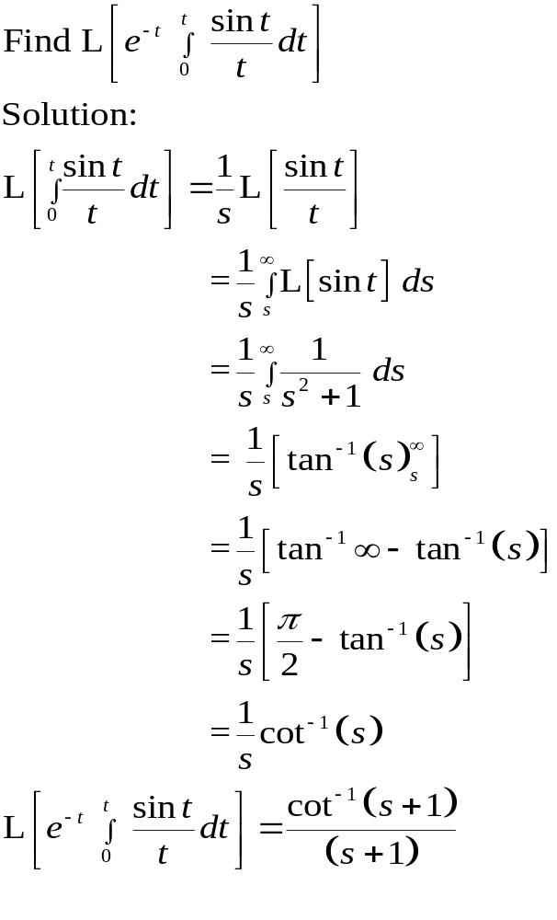

Slide 46
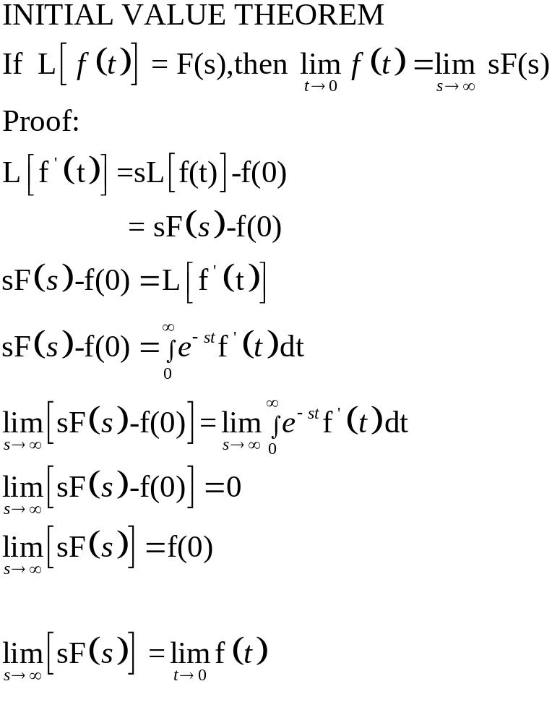

Slide 47
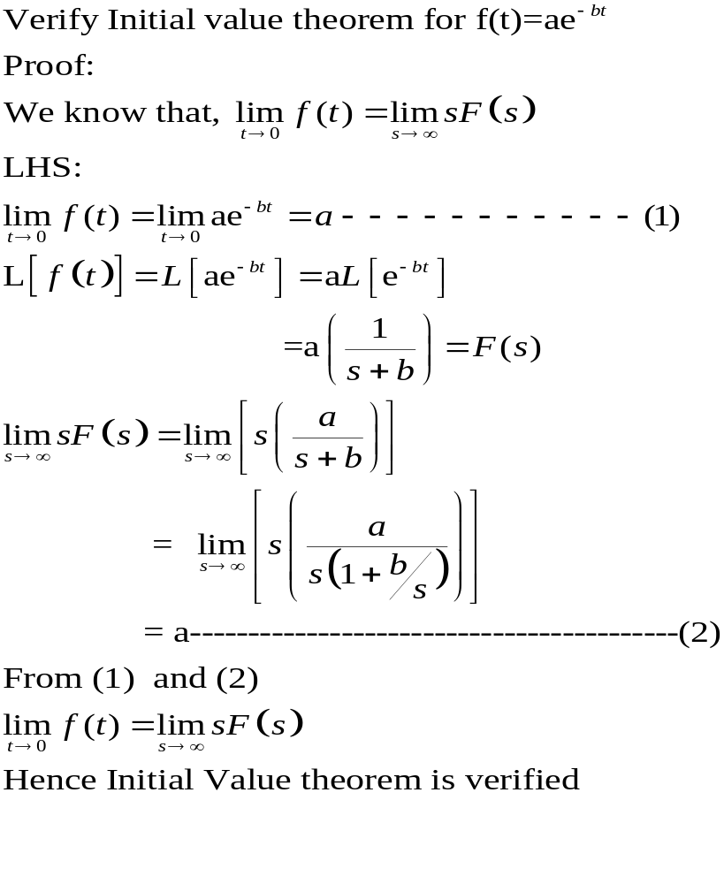

Slide 48
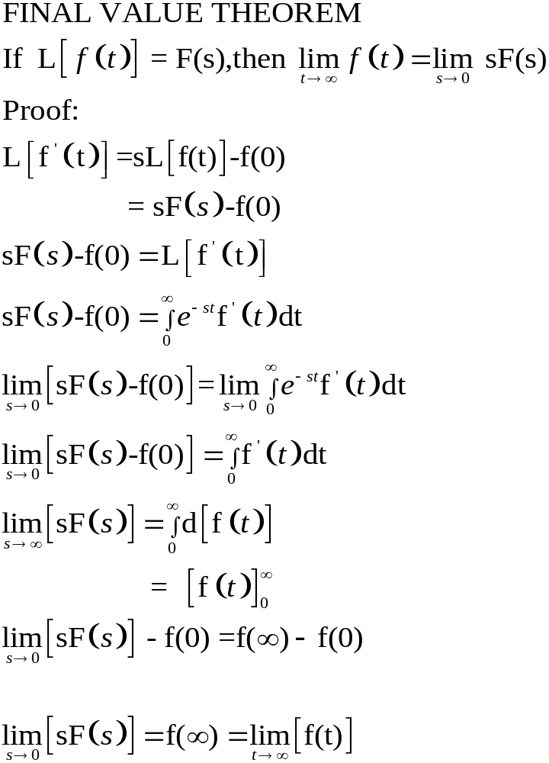

Slide 49
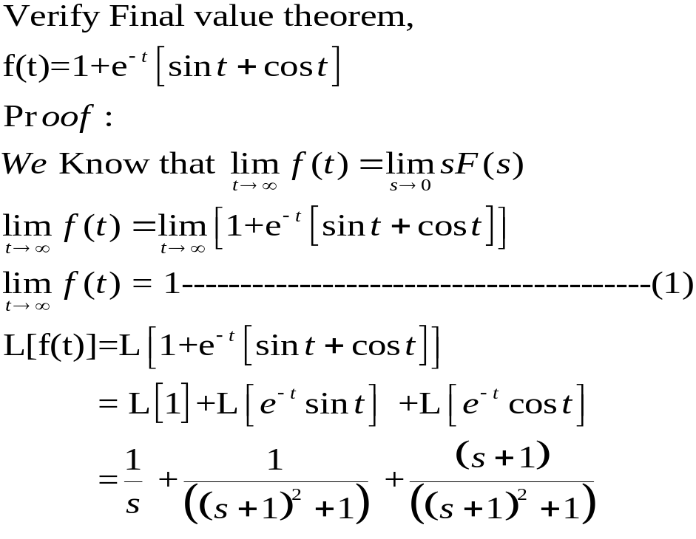

Slide 50
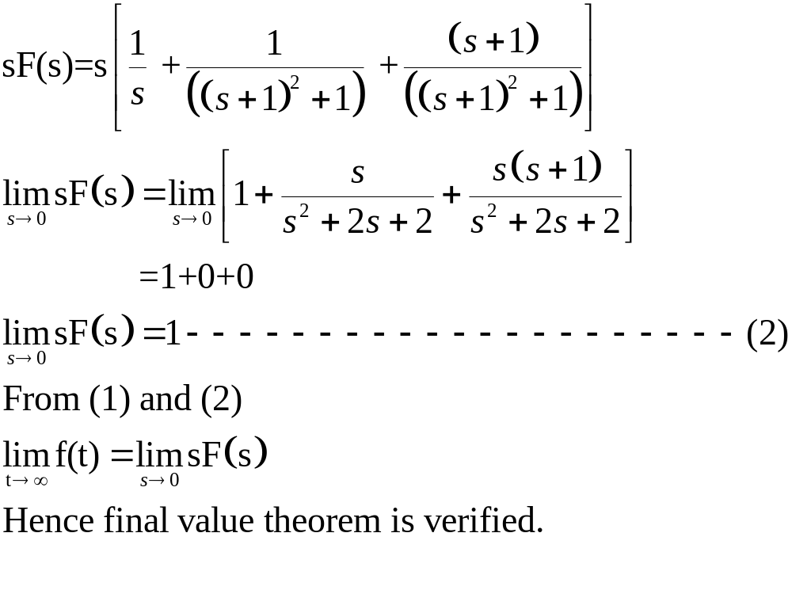

Slide 51
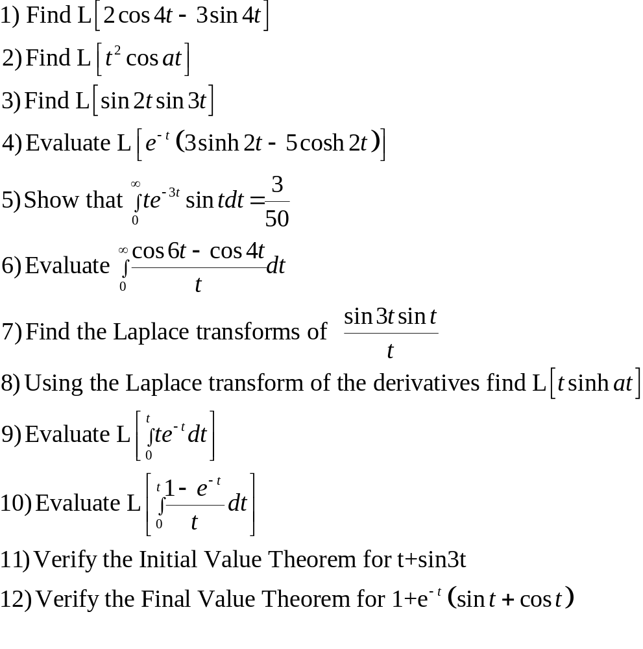

Slide 52
PERIODIC FUNCTIONS
A Function f(t) is said to have a period T if for all t,
f( T + t ) = f( t ) where T is a positive constant . The least value of T>0 is
called period of f(t).
Eg: Consider f(t) = sin t
f (t+ 2π )= sin t = f(t)
f (t+ 4π) = sin t = f(t)
……………….
………………..
Therefore, Sin t is a periodic function with period 2π.

Slide 53
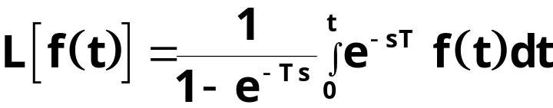
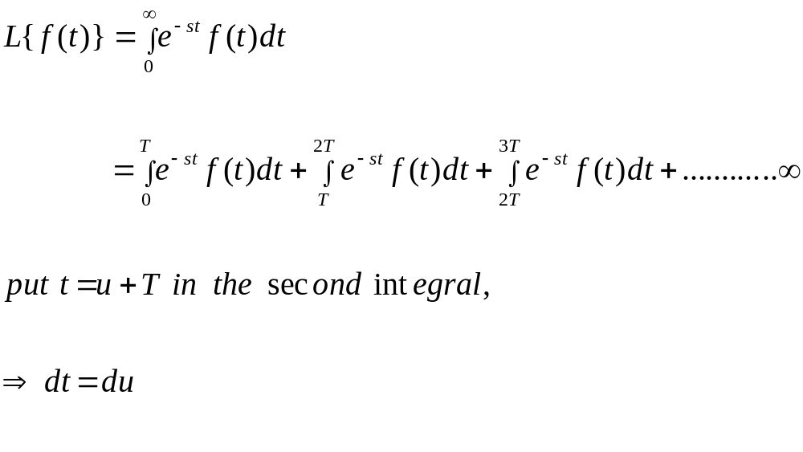
LAPLACE TRANSFORM OF PERIODIC FUNCTIONS
If f (t) is a piecewise continuous periodic functions with period T then
By definition of Laplace Transform

Slide 54
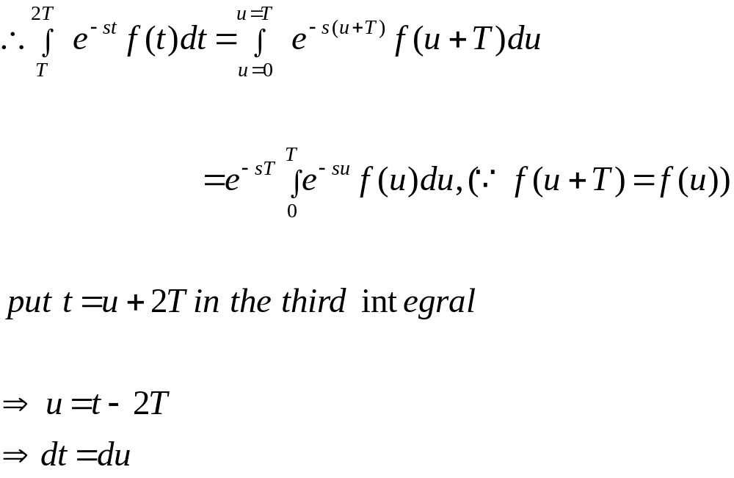

Slide 55


Slide 56


Slide 57


Slide 58


Slide 59


Slide 60


Slide 61


Slide 62


Slide 63


Slide 64


Slide 65


Slide 66


Slide 67


Slide 68


Slide 69


Slide 70


Slide 71


Slide 72


Slide 73


Slide 74


Slide 75


Slide 76


Slide 77


Slide 78


Slide 79


Slide 80


Slide 81


Slide 82


Slide 83


Slide 84


Slide 85


Slide 86


Slide 87


Slide 88


Slide 89


Slide 90


Slide 91


Slide 92


Slide 93


Slide 94


Slide 95


Slide 96


Slide 97


Slide 98


Slide 99



Slide 100


Slide 101


Slide 102


Slide 103


Slide 104


Slide 105


Slide 106


Slide 107


Slide 108


Slide 109


Slide 110


Slide 111



Slide 112


Slide 113


Slide 114


Slide 115


Slide 116


Slide 117


Slide 118


Slide 119


Slide 120


Slide 121


Slide 122


Slide 123


Slide 124


Slide 125


Slide 126

Solving linear second order ordinary differential equations with constant coefficient

Slide 127


